Slide 1
IPL Visualization
By JAIVARDHAN

Slide 2
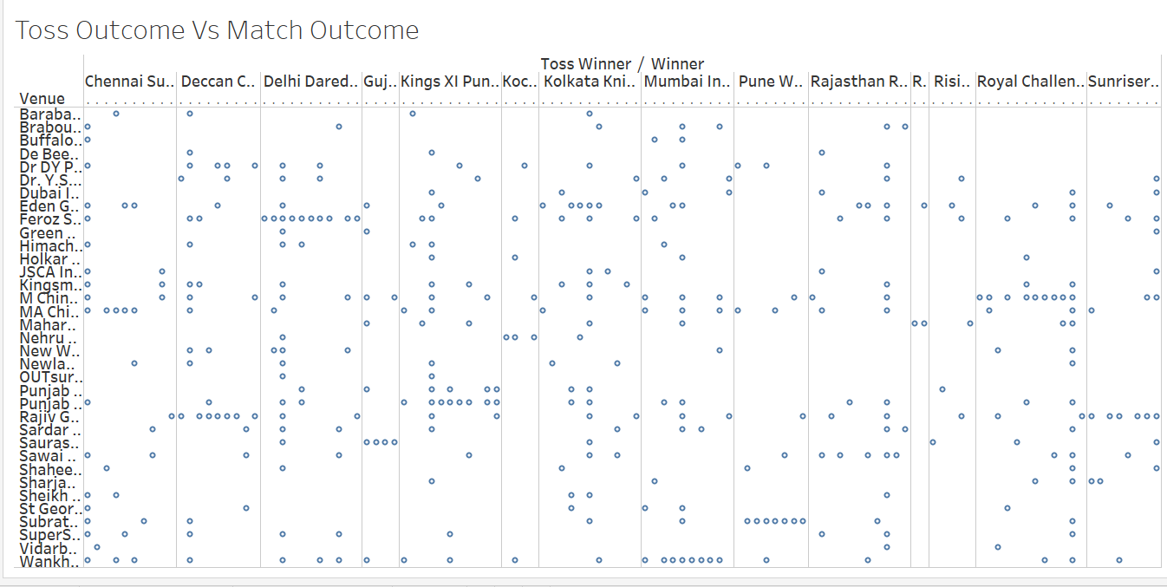
Toss VS Match Outcome (For Each Ground)
The Probability can differ among different chances that are present in the matches. Therefore, we have a large chunk of database.

Slide 3
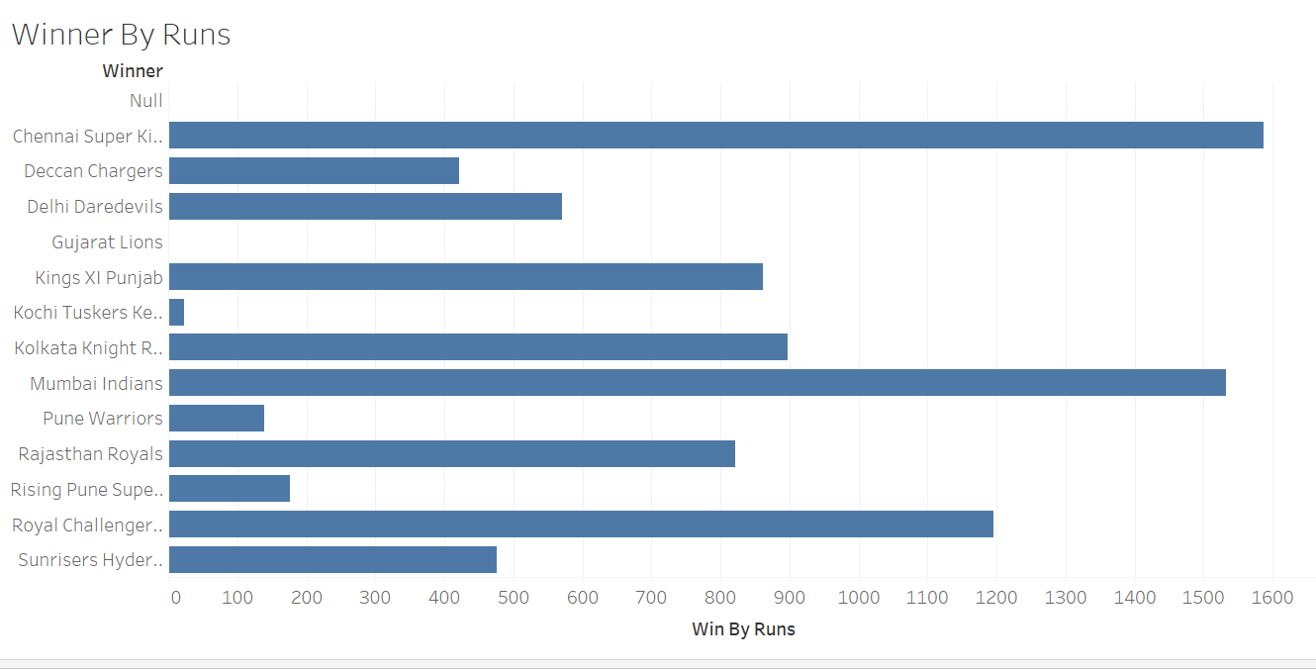
Biggest Wines by runs
The biggest win by runs goes to Chennai super kings followed by Mumbai Indians.
However, the team with the lowest number of wins through runs is Gujrat titans.

Slide 4
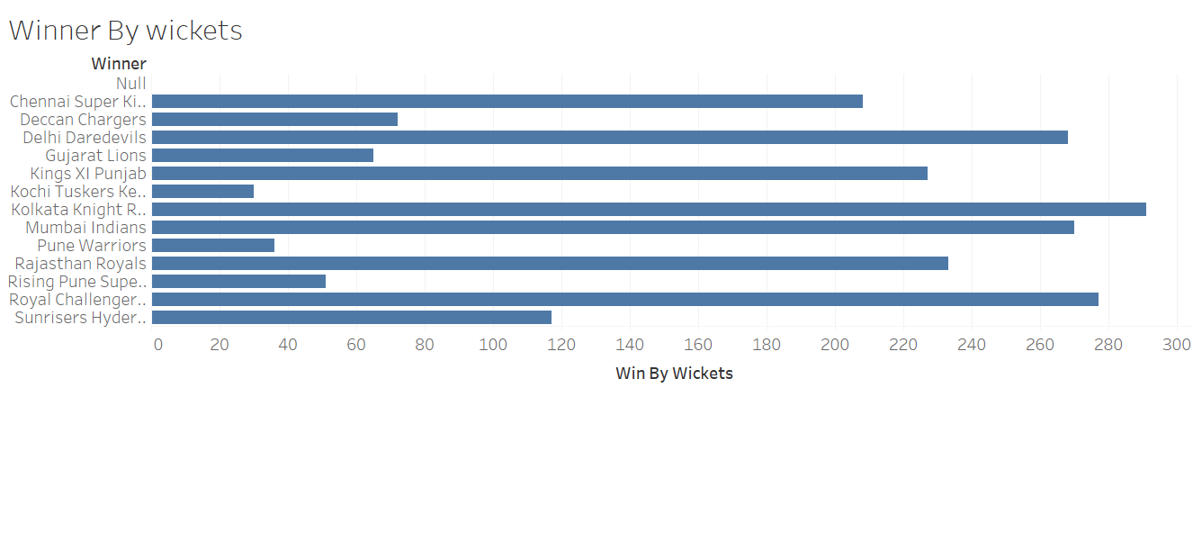
Biggest Wins by wickets
The biggest runs with wickets is achieved by Kolkata Night Riders followed by Royal Challengers Bangalore.
The team with the least wins by wicket is Kochi Tuskers Kerela.

Slide 5
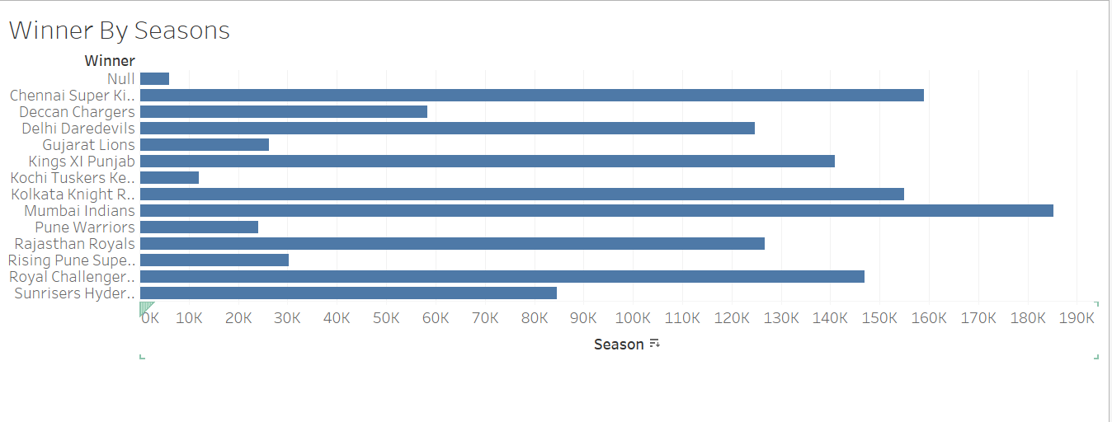
Highest total across all seasons
Mumbai Indians has the highest wins by seasons, followed by Chennai Super Kings and Kolkata Knight Riders.
The least wins in all the seasons are of Kochi Tuskers Kerela.

Slide 6
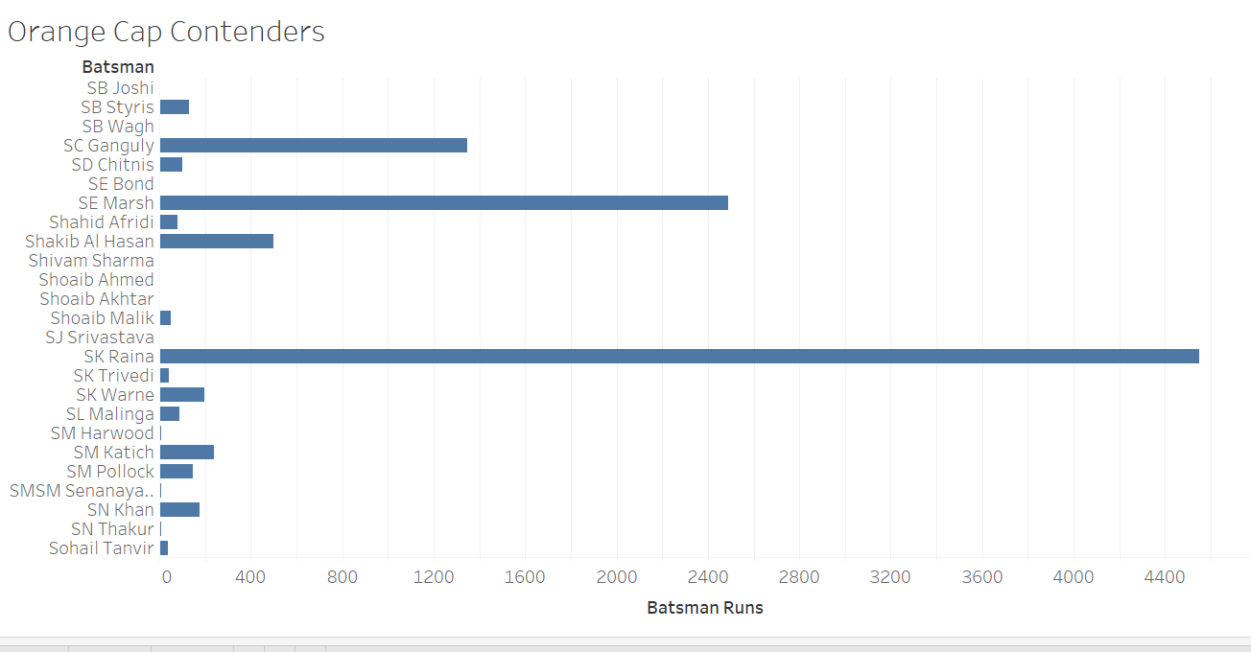
Orange Cap contenders
The Orange cap contenders are the Batsman with the highest number of runs across the seasons.
The Orange cap contenders is SK Raina.

Slide 7
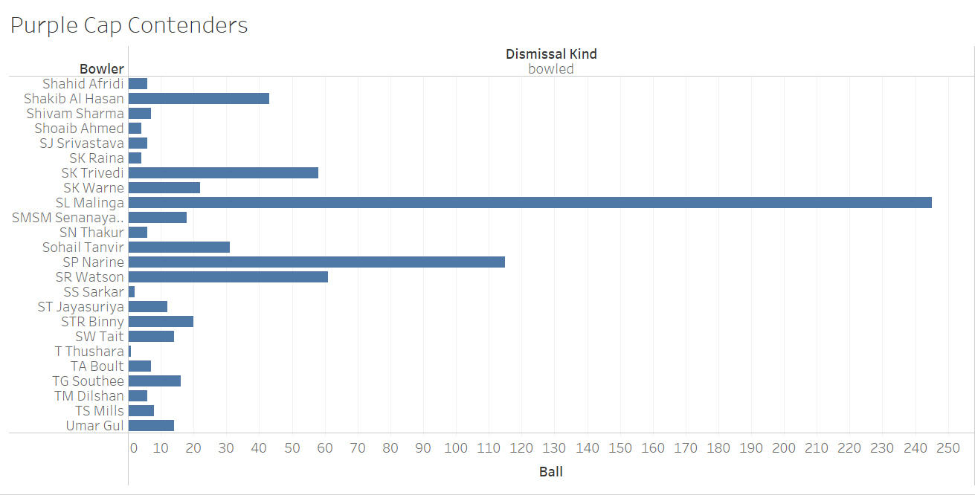
Purple Cap contenders
The Purple cap contenders are the bowlers who have taken the maximum number of wickets in a particular season.
The Bowler with the highest number of wickets is

Slide 8
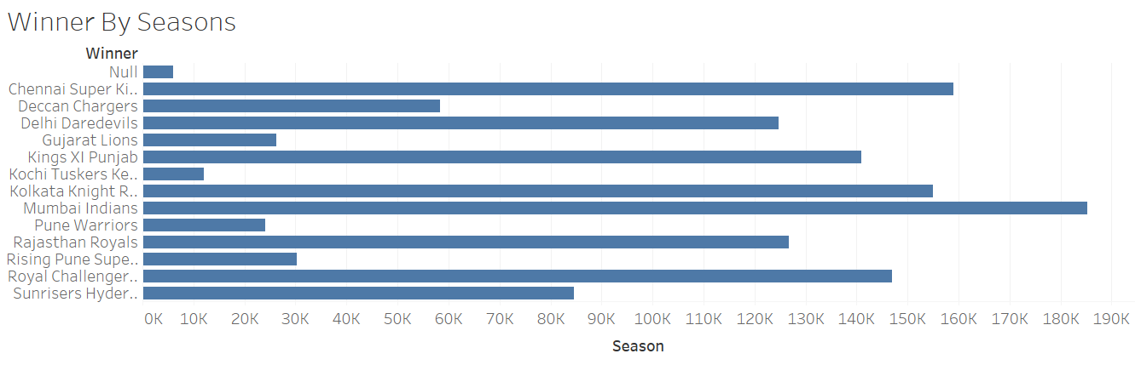
Winner By Seasons
The highest number of wins across all the seasons is of Mumbai Indians. Followed by Chennai super kings.

